Slide 1
BENGALURU HOUSE PRICE
ANALYSIS
Powered by ALHAJ

Slide 2
Introduction
Project: Bengaluru House Price Analysis
Tool: Microsoft Excel
Aim: To study how house prices change by area and size
• Data collected from verified real estate listings.
Powered by ALHAJ

Slide 3
Problem Statement
• House prices vary significantly across different locations in Bengaluru.
• Property size and area type influence overall pricing.
• Analysis helps identify key factors affecting property prices.
Powered by ALHAJ

Slide 4
Dataset Overview
• Data Source: Verified real estate listings.
• Total Records: 13,000+ rows.
• Key Columns: Location, total Sqft, Bath, Balcony, Size, Price.
• Added Columns: Price Category, Area Type.
Powered by ALHAJ

Slide 5
Methodology
• Collected housing data in Excel.
• Checked for missing values (no null values found).
• Added new columns using formulas.
Area Type =IF(B2<1000,"Small",
IF(B2<=2000,"Medium","Large"))
Price Category =IF(G2<500000,"Low",
IF(G2<1000000,"Medium",
IF(G2<2000000,"High","Luxury")))

Slide 6
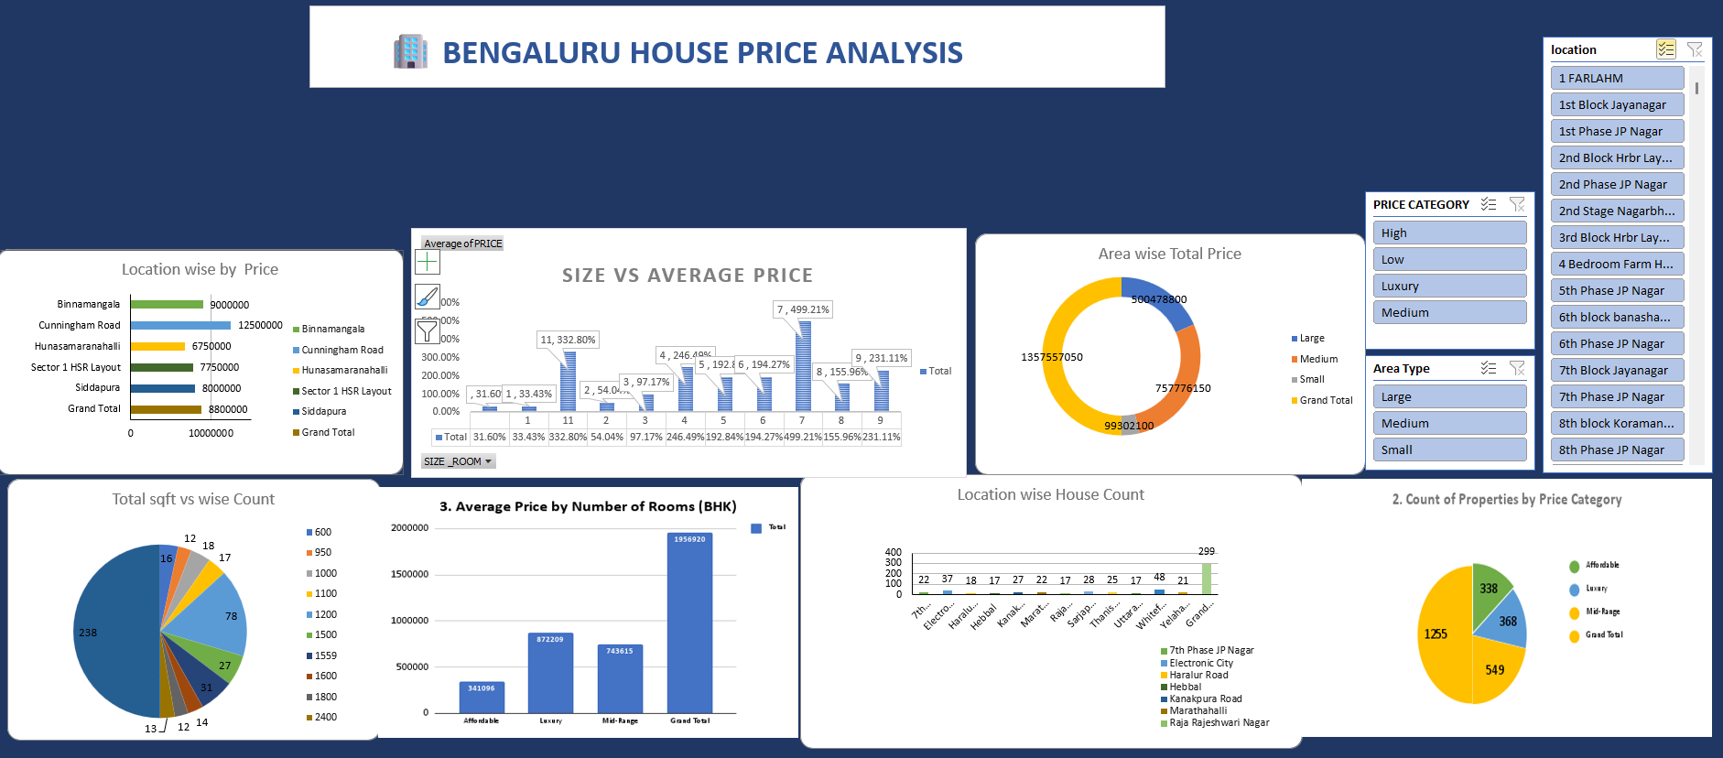
Dashboard Visualization
Powered by ALHAJ

Slide 7
Summary
The Bengaluru housing market shows significant variation in house prices based on location, area size, and property type. This analysis highlights key pricing patterns and supports smarter decision-making for home buyers and investors.
Powered by ALHAJ

Slide 8
Conclusion
The analysis shows that location and property size play a major role in deciding house prices in Bengaluru.
Excel tools like Pivot Tables and Charts helped to clean, analyze, and visualize the data easily.
The project provides a clear understanding of Bengaluru’s real estate trends and helps in making better housing decisions.
Overall, this study shows how data analysis can simplify real-world problems effectively.

